Slide 1
Political Actor Recommendation
Team Members:
Harsh Bhavsar
Harshal Mehta
Khushbu Patil
Mittal Patel
Shruti Shetye

Slide 2
Motivation
Advancement in Big Data
Less manual dependencies
Higher accuracy
More efficiency
Efficient error handling
One such use case of human dependencies is the use of dictionaries to look up actors and actions involved in potential events
Current Scenario: Such dictionaries are managed and updated by humans with a high cost and infrequent updating – resulting into loss of important data/information

Slide 3
Project Objective
To overcome the existing manual dependencies and error handling
Prevent loss of valuable data / information due to infrequent table updating
To identify missing and new data (actors) using Automatic Content Extraction
Provide recommendations for new actors for multiple time frames using frequency-based actor ranking algorithm

Slide 4
Technical View Point
Fetching input data using Apache Kafka at periodic intervals
Consuming data using Spark-Streaming and Apache Kafka
Technologies / tools used:
Apache Kafka
Spark Streaming library
Java programming language
NoSQL (Redis)
Stanford Core NLP library
Stanford NER
CAMEO action directory
Various APIs (NY Times API)

Slide 5
Introduction (Contd.)
Encoding of political data done by humans or machine learning
Dictionaries of actors and actions are maintained
Strong need of processing political data to extract useful information such as politicians and their roles in various organization
Identification and addition of new political actors and their roles into the database
Process is very slow and inefficient when done by humans

Slide 6
Introduction (Contd.)
Recommending an actor based on preexisting data creates an issue when the information about that actor is not updated in the dictionaries yet.
Machine learning based semantic labeling techniques to identify verbs, nouns, etc.
Using these techniques we can identify names of political actors and their existing roles too.

Slide 7



Work Flow
Data Collection
Kafka
SPARK
Metadata Extraction
DOC N,
Window M
(Parse, NER)
Political Actor Extraction
New Political Actor Recommendation
New Actors

Slide 8
Technical Flow
CoreNLP
NER
Unknown Actor List
Filter
Group
Actor
Actor list
Actor list
Actor list
Actor list

Slide 9
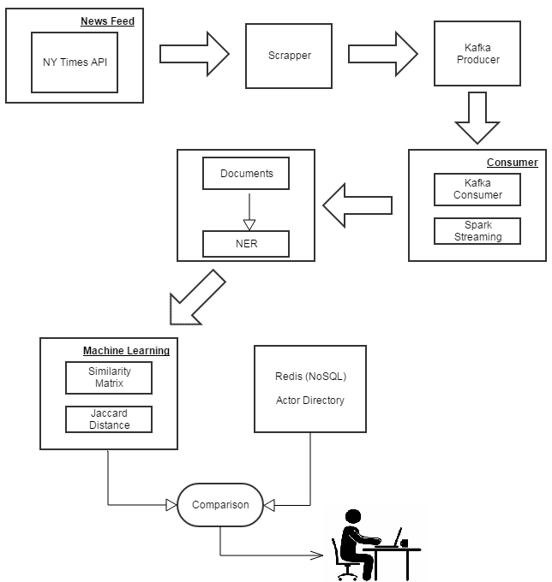
Detailed View

Slide 10
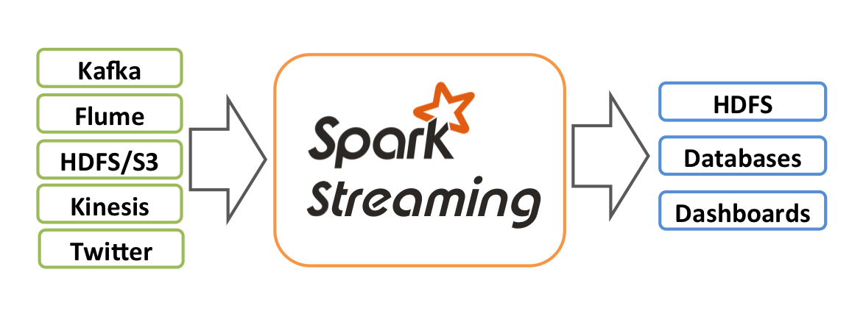
Spark Streaming
Introduction
Usage in Project
Spark Streaming- An extension of the core Spark API that enables processing of live data streams
Data can be ingested from many sources like Kafka, Flume, Twitter, ZeroMQ, Kinesis, or TCP sockets
Data can be processed using high-level functional programming and can be applied Spark’s machine learning algorithms on data streams
Used for periodic processing of the news article (data)
To filter political actors using NER and interfacing with our own CAMEO like dictionary which uses NoSQL
K-means clustering implemented for grouping actors based aliases.

Slide 11
Apache Kafka
Introduction
Usage in Project
A commit log service on top of Spark-streaming
It provides functionality of messaging system like JMS (Java Messaging Service)
Useful to handle streaming and live data
To port the metadata to Spark Streaming.
High fault tolerance.

Slide 12
Stanford NER
Introduction
Usage in Project
A Java implementation of a Named Entity Recognizer
Labels sequences of words in a text which are the names of things, such as person and company names, or gene and protein names
Good named entity recognizers for English, particularly for the 3 classes (PERSON, ORGANIZATION, LOCATION)
To locate and classify named entities in input text, into predefined categories like Person, Location, etc.

Slide 13
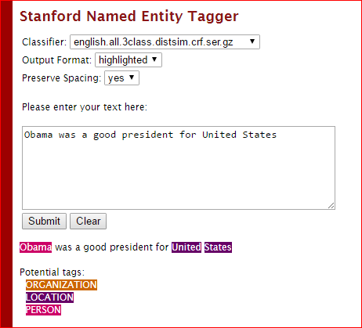
Stanford NER

Slide 14
Challenges Encountered
Difficulty handling multi-alias names
Figuring out batch size for news API so that there is significant updates
Preventing false aggregation of actors with highly similar names

Slide 15
Future Scope
NoSQL
Donald J Trump
Barrack H Obama
Donald
Donald J
Trump
Barrack
Barrack H
Obama

Slide 16
Future Scope
Can be extended further to include a Graphical UI
Built-in framework for role-discovery and appropriate role prediction
Similarity computation improvement to eliminate false aggregation

Slide 17
References
Discover New Actors In Politics: A Framework To Recommend Political Actors With Role In Real-time Paper by : Mohiuddin Solaimani , Sayeed Salam , Latifur Khan , Patrick T. Brandt and Vito D’Orazio
Stanford NER - https://nlp.stanford.edu/software/CRF-NER.shtml
Spark Streaming - spark.apache.org/docs/latest/streaming-programming-guide.html
News API - https://newsapi.org/
Kafka - https://kafka.apache.org/
NY Times API - https://developer.nytimes.com/
Redis – https://redis.io/
CAMEO - http://eventdata.parusanalytics.com/data.dir/cameo.html

Slide 18


